Slide 1

Chapter 4. Continuous Random Variables and Probability Distributions
Weiqi Luo (骆伟祺)
School of Data & Computer Science
Sun Yat-Sen University
Email：luoweiqi@mail.sysu.edu.cn

Slide 2
Chapter four:
Continuous Random Variables and Probability Distributions
4.1 Probability Density Functions
4.2 Cumulative Distribution Functions and Expected Values
4.3 The Normal Distribution
4.4 The Exponential and Gamma Distributions
4.5 Other Continuous Distributions
4.6 Probability Plots

Slide 3
4.1 Probability Density Functions
Continuous Random Variables
A random variable X is said to be continuous if its set of possible values is an entire interval of numbers – that is , if for some A<B, any number x between A and B is possible

Slide 4
4.1 Probability Density Functions
Example 4.2
If a chemical compound is randomly selected and its PH X is determined, then X is a continuous rv because any PH value between 0 and 14 is possible. If more is know about the compound selected for analysis, then the set of possible values might be a subinterval of [0, 14], such as 5.5 ≤ x ≤ 6.5, but X would still be continuous.
0
5.5
6.5
14

Slide 5
4.1 Probability Density Functions
Probability Distribution for Continuous Variables
Suppose the variable X of interest is the depth of a lake at a randomly chosen point on the surface. Let M be the maximum depth, so that any number in the interval [0,M] is a possible value of X.
0
M
0
M
0
M
4.1(a)
4.1(b)
4.1(c)
Measured by meter
Measured by centimeter
A limit of a sequence of
discrete histogram
Discrete Cases
Continuous Case

Slide 6
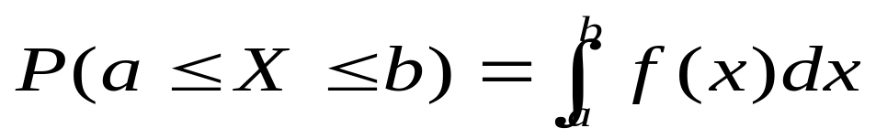
4.1 Probability Density Functions
Probability Distribution
Let X be a continuous rv. Then a probability distribution or probability density function (pdf) of X is f(x) such that for any two numbers a and b with a ≤ b
The probability that X takes on a value in the interval [a,b] is the area under the graph of the density function as follows.
f(x)
a
b
x

Slide 7
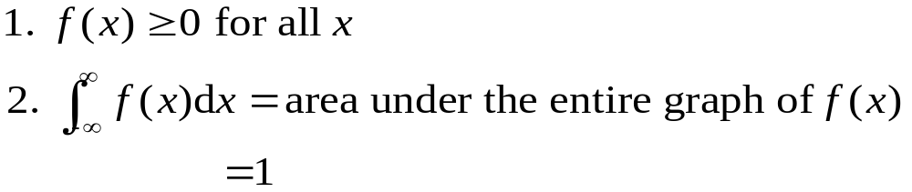
4.1 Probability Density Functions
A legitimate pdf should satisfy
f(x)
a
b
x

Slide 8
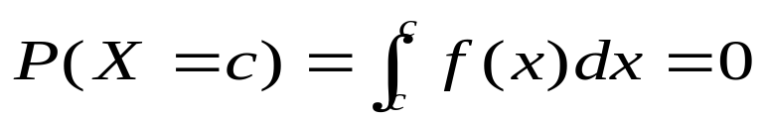
4.1 Probability Density Functions
pmf (Discrete) vs. pdf (Continuous)
p(x)
f(x)
0
M
0
M
P(X=c) = p(c)
P(X=c) = f(c) ?

Slide 9
4.1 Probability Density Functions
Proposition
If X is a continuous rv, then for any number c, P(X=c)=0. Furthermore, for any two numbers a and b with a<b,
P(a≤X ≤b) = P(a<X ≤b)
= P(a ≤X<b)
= P(a <X<b)
Impossible event :the event contain no simple element
P(A)=0 ➔ A is an impossible event ?

Slide 10
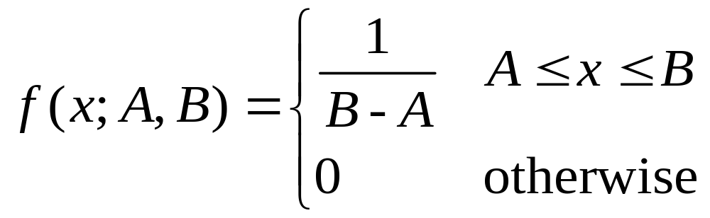
4.1 Probability Density Functions
Uniform Distribution
A continuous rv X is said to have a uniform distribution on the interval [A, B] if the pdf of X is

Slide 11
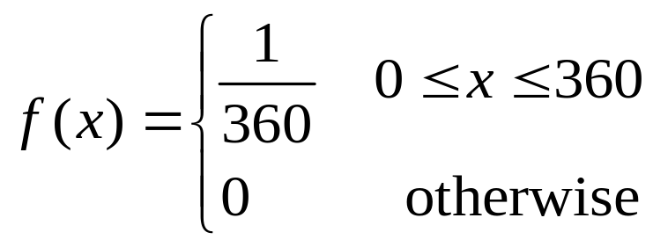
4.1 Probability Density Functions
Example 4.4
The direction of an imperfection with respect to a reference line on a circular object such as a tire, brake rotor, or flywheel is, in general, subject to uncertainty. Consider the reference line connecting the valve stem on a tire to the center point, and let X be the angle measured clockwise to the location of an imperfection, One possible pdf for X is

Slide 12

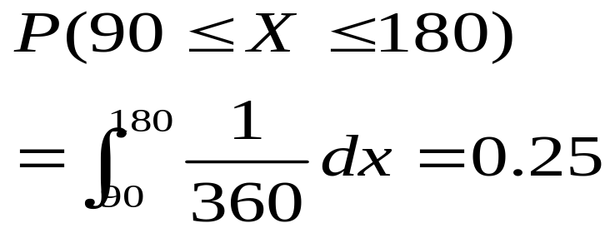
4.1 Probability Density Functions
Example 4.3 (Cont’)
f(x)
90
180
360

Slide 13
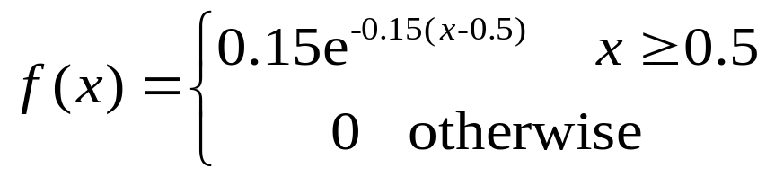
4.1 Probability Density Functions
Example 4.5
“Time headway” in traffic flow is the elapsed time between the time that one car finishes passing a fixed point and the instant that the next car begins to pass that point. Let X = the time headway for two randomly chosen consecutive cars on a freeway during a period of heavy flow. The following pdf of X is essentially the one suggested in “The Statistical Properties of Freeway Traffic”.

Slide 14
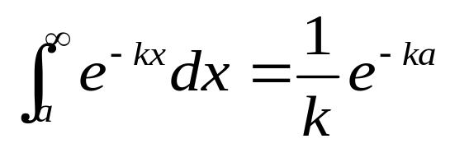
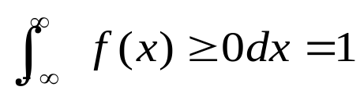
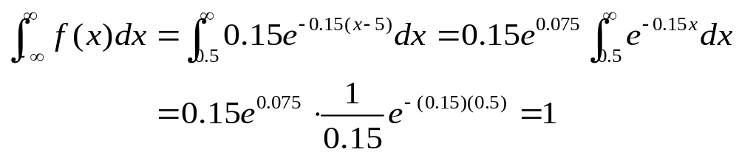
4.1 Probability Density Functions
Example 4.4 (Cont’)
1. f(x) ≥ 0;
2. to show , we use the result

Slide 15

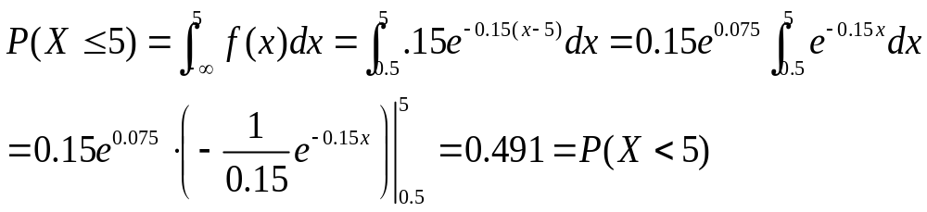
4.1 Probability Density Functions
Example 4.4 (Cont’)
f(x)
0.15
x
0.5
2
4
6
8
10

Slide 16
4.1 Probability Density Functions
Homework
Ex. 2, Ex. 5, Ex. 8

Slide 17
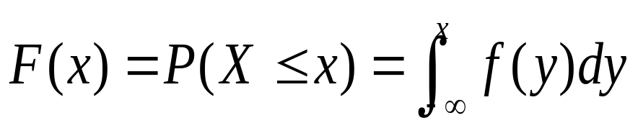
4.2 Cumulative Distribution Functions and Expected Values
Cumulative Distribution Function
The cumulative distribution function F(x) for a continuous rv X is defined for every number x by
For each x, F(x) is the area under the density curve to the left of x as follows
f(x)
F(x)
F(8)
1
F(8)
0.5
x
x
5
10
5
10
8
8

Slide 18
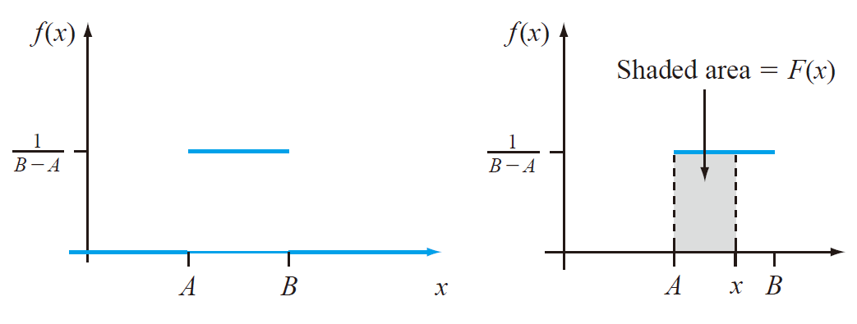
4.2 Cumulative Distribution Functions and Expected Values
Example 4.6
Let X, the thickness of a certain metal sheet, have a uniform distribution on [A, B]. The density function is shown as follows.
For x < A, F(x) = 0, since there is no area under the graph of the density function to the left of such an x.
For x ≥ B, F(x) = 1, since all the area is accumulated to the left of such an x.

Slide 19
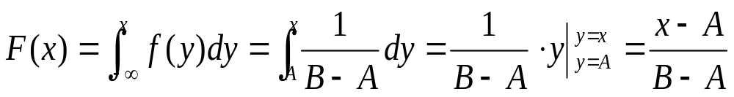
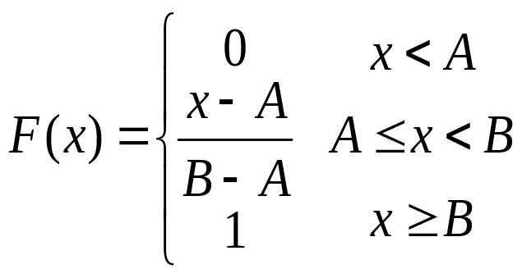
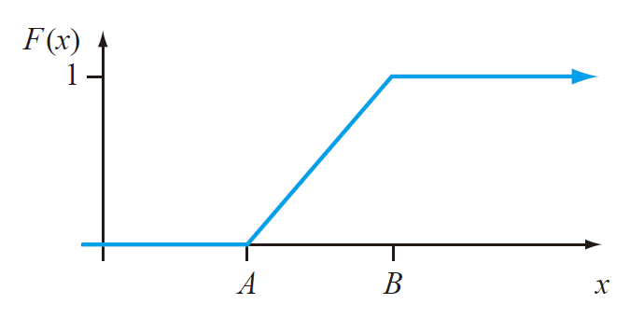
4.2 Cumulative Distribution Functions and Expected Values
Example 4.6 (Cont’)
For A ≤X≤ B
Therefore, the entire cdf is

Slide 20


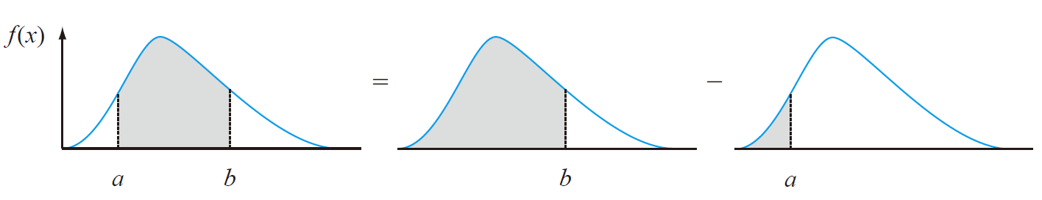
4.2 Cumulative Distribution Functions and Expected Values
Using F(x) to compute probabilities
Let X be a continuous rv with pdf f(x) and cdf F(x). Then for any number a
and for any two numbers a and b with a<b

Slide 21
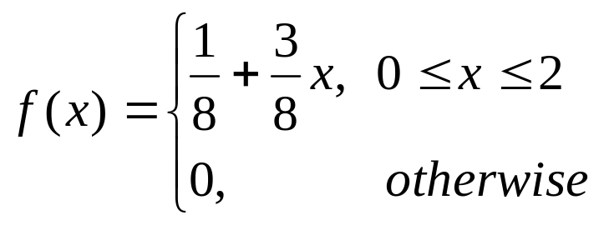
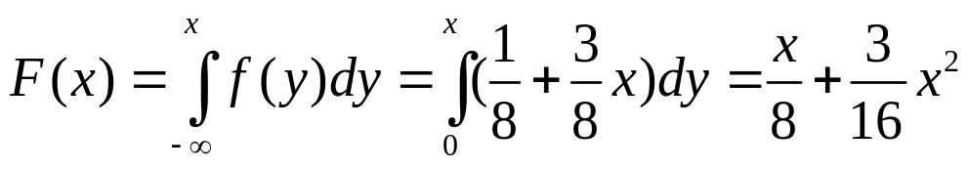
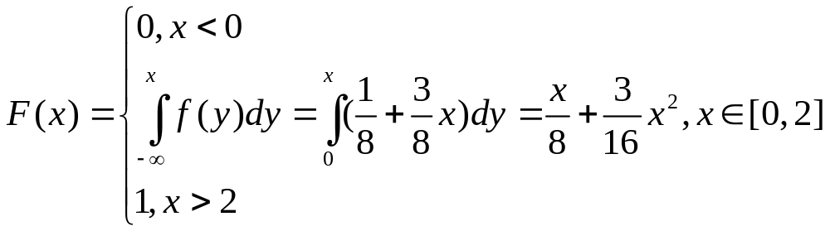
4.2 Cumulative Distribution Functions and Expected Values
Example 4.7
Suppose the pdf of the magnitude X of a dynamic load on a bridge is given by
For any number x between 0 and 2,
thus

Slide 22
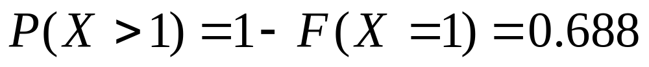
4.2 Cumulative Distribution Functions and Expected Values
Example 4.7 (Cont’)
f(x)
F(x)
7/8
1
1/8
2
0
2

Slide 23
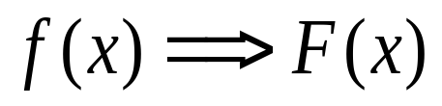
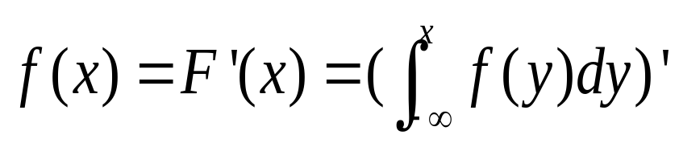
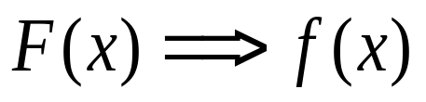
4.2 Cumulative Distribution Functions and Expected Values
Obtaining f(x) form F(x)
If X is a continuous rv with pdf f(x) and cdf F(x), then at every x at which the derivative F’(x) exists, F’(x)=f(x)

Slide 24
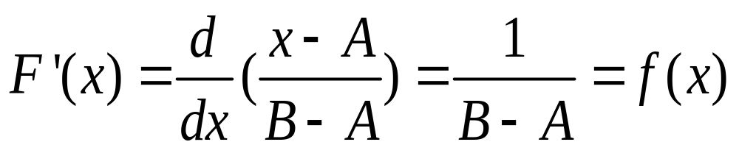
4.2 Cumulative Distribution Functions and Expected Values
Example 4.8 (Ex. 4.6 Cont’)
When X has a uniform distribution, F(x) is differentiable except at x=A and x=B, where the graph of F(x) has sharp corners. Since F(x)=0 for x<A and F(x)=1 for x>B, F’(x)=0=f(x) for such x. For A<x<B

Slide 25
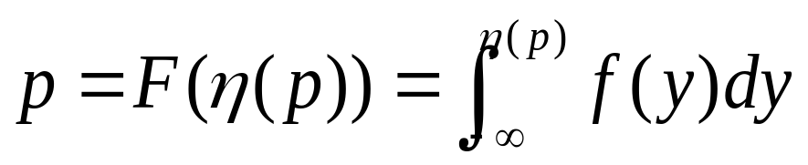


4.2 Cumulative Distribution Functions and Expected Values
Percentiles of a Continuous Distribution
Let p be a number between 0 and 1. The (100p)th percentile of the distribution of a continuous rv X , denoted by η(p), is defined by
Shaded area=p
F(x)
f(x)
1

Slide 26
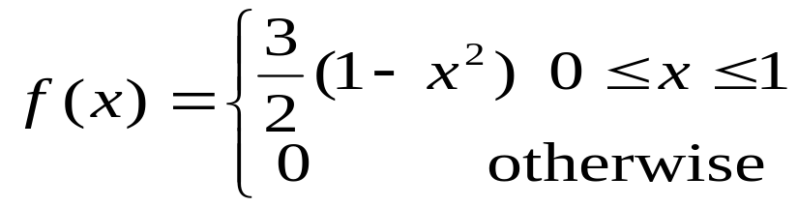
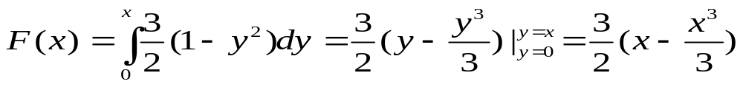
4.2 Cumulative Distribution Functions and Expected Values
Example 4.9
The distribution of the amount of gravel (in tons) sold by a particular construction supply company in a given week is a continuous rv X with pdf
The cdf of sales for any x between 0 and 1 is

Slide 27
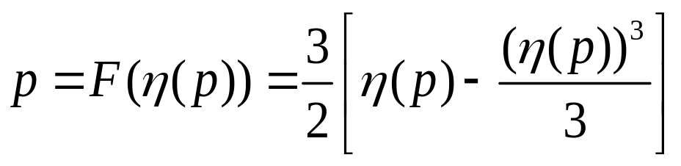
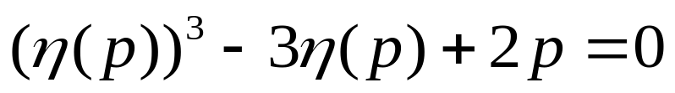

4.2 Cumulative Distribution Functions and Expected Values
Example 4.9 (Cont’)
F(x)
1
.5
0
0.347
1
x

Slide 28

4.2 Cumulative Distribution Functions and Expected Values
The median
The median of a continuous distribution, denoted by , is the 50th percentile, so satisfies 0.5=F( ), that is, half the area under the density curve is to the left of and half is to the right of
Symmetric Distribution

Slide 29
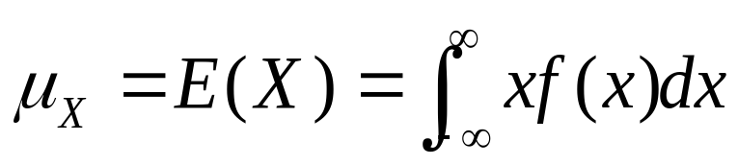
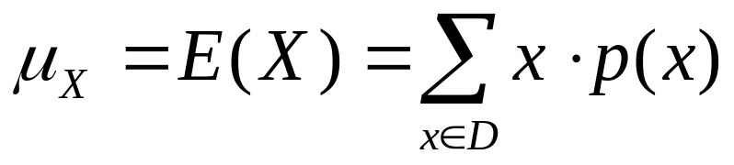
4.2 Cumulative Distribution Functions and Expected Values
Expected/Mean Value
The expected/mean value of a continuous rv X with pdf f(x) is
Discrete Case

Slide 30
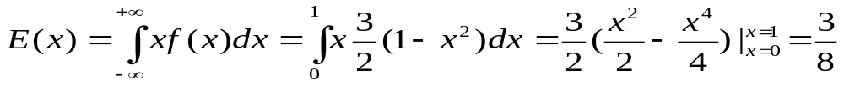
4.2 Cumulative Distribution Functions and Expected Values
Example 4.10 (Ex. 4.9 Cont’)
The pdf of weekly gravel sales X was
So

Slide 31
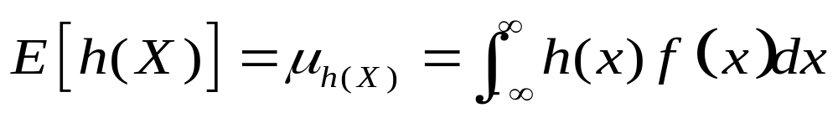
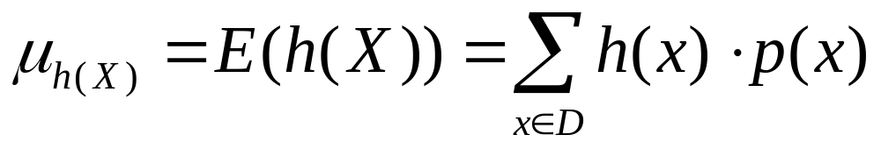
4.2 Cumulative Distribution Functions and Expected Values
Expected value of a function
If X is a continuous rv with pdf f(x) and h(X) is any function of X, then
Discrete Case

Slide 32
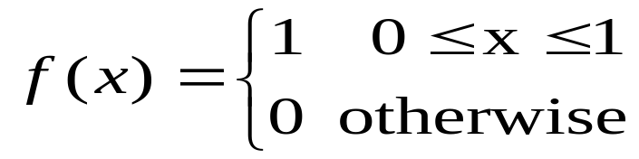
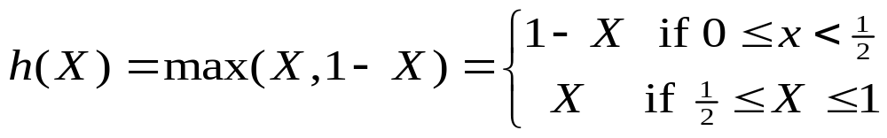
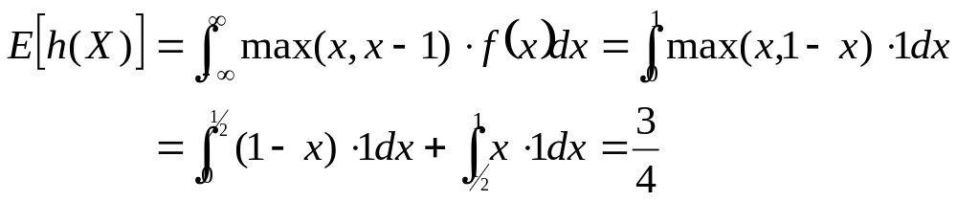
4.2 Cumulative Distribution Functions and Expected Values
Example 4.11
Two species are competing in a region for control of a limited amount of a certain resource. Let X = the proportion of the resource controlled by species 1 and suppose X has pdf
which is a uniform distribution on [0,1]. Then the species that controls the majority of this resource controls the amount
The expected amount controlled by the species having majority control is then

Slide 33
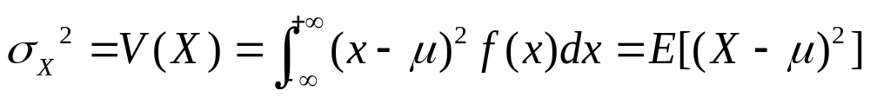
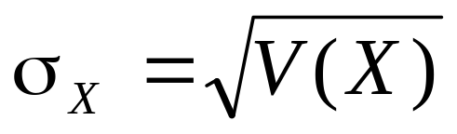
4.2 Cumulative Distribution Functions and Expected Values
The Variance
The variance of a continuous random variable X with pdf f(x) and mean value μ is
The standard deviation (SD) of X is

Slide 34
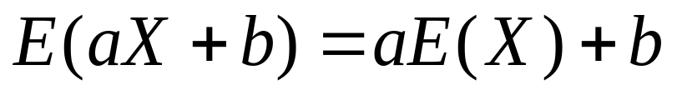
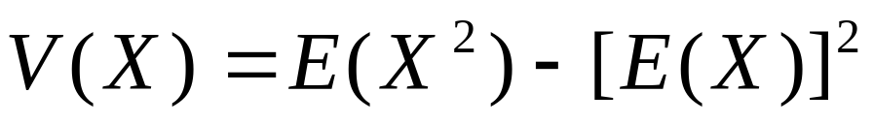
4.2 Cumulative Distribution Functions and Expected Values
Proposition
The Same Properties as Discrete Cases

Slide 35
4.2 Cumulative Distribution Functions and Expected Values
Homework
Ex. 13, Ex. 18, Ex. 22, Ex. 24

Slide 36
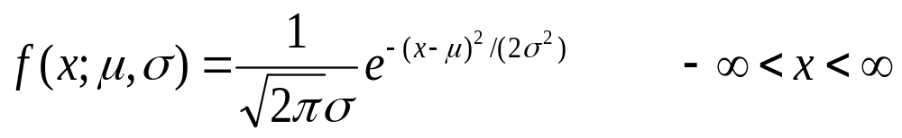
4.3 The Normal Distribution
Normal (Gaussian) Distribution
A continuous rv X is said to have a normal distribution with parameters μ and σ (or μ and σ²), where -∞ < μ < +∞ and 0 < σ, if the pdf of X is
Note:
The normal distribution is the most important one in all of probability and statistics. Many numerical populations have distributions that can be fit very closely by an appropriate normal curve.
Even when the underlying distribution is discrete, the normal curve often gives an excellent approximation.
Central Limit Theorem (see next Chapter)

Slide 37
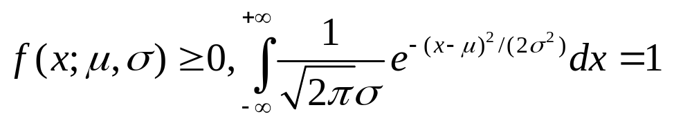

4.3 The Normal Distribution
Properties of f(x;μ,σ)
Proof?
E(X) = μ & V(X) = σ² , X~ N(μ, σ² )
σ is large
σ is medium
σ is small
Symmetry Shape

Slide 38
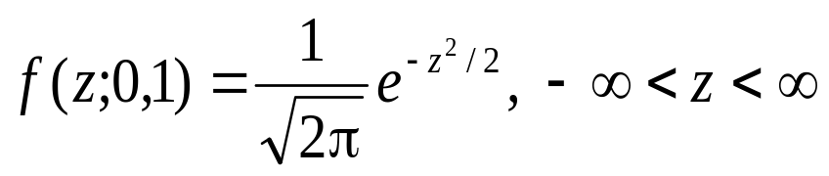

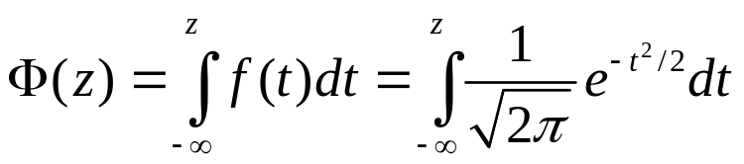
4.3 The Normal Distribution
Standard Normal Distribution
The normal distribution with parameter values μ=0 and σ=1 is called the standard normal distribution. A random variable that has a standard normal distribution is called a standard normal random variable and will be denoted by Z. The pdf of Z is
The cdf of Z is
Shaded area=
f(z;0,1)
0
z
Refer to Appendix Table A.3

Slide 39
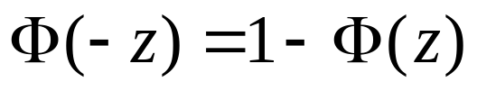
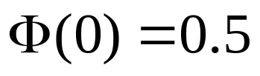
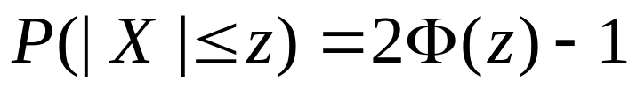
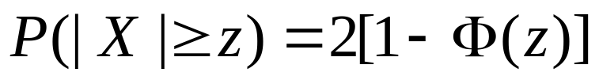
4.3 The Normal Distribution
Properties of Φ(z)

Slide 40


4.3 The Normal Distribution
Example 4.13
(a) P(Z≤1.25) (b) P(Z>1.25) (c) P(Z ≤-1.25)
Shaded area=
0
1.25
z curve
Shaded area=
0
1.25
-1.25
0

Slide 41
4.3 The Normal Distribution
Example 4.13 (Cont’)
(d) P(-0.38 ≤ Z ≤ 1.25)
=
-
-0.38
0
1.25
0
1.25
-0.38
0

Slide 42



4.3 The Normal Distribution
z_{α} notation
z_{α} will denote the values on the measurement axis for which α of the area under the z curve lies to the right of z_{α}
Note: Z_{α} is the 100(1- α)th percentile of the standard normal distribution
Percentile
(tail area)
90 95 97.5 99 99.5 99.9 99.95
0.1 0.05 0.025 0.01 0.005 0.001 0.0005
1.28 1.645 1.96 2.33 2.58 3.08 3.27

Slide 43



4.3 The Normal Distribution
Nonstandard Normal Distribution
If X has the normal distribution with mean μ and standard deviation σ, then
has a standard normal distribution (why?). Thus

Slide 44



4.3 The Normal Distribution
Equality of nonstandard and standard normal curve area
σ =1
x
(x- μ)/ σ
Percentiles of an Arbitrary Normal Distribution

Slide 45



4.3 The Normal Distribution
Example 4.16
The time that it takes a driver to react to the brake lights on a decelerating vehicle is critical in helping to avoid rear-end collisions . Reaction time for an in-traffic response to a brake signal from standard brake lights can be modeled with a normal distribution having mean value 1.25 sec and standard deviation of .46 sec . What is the probability that reaction time is between 1.00 sec and 1.75 sec?

Slide 46




4.3 The Normal Distribution
Example 4.17
The breakdown voltage of a randomly chosen diode of a particular type is known to be normally distributed. What is the probability that a diode’s breakdown voltage is within 1 standard deviation of its mean value?
Note: This question can be answered without knowing either μ or σ, as long as the distribution is known to be normal; in other words , the answer is the same for any normal distribution:

Slide 47
4.3 The Normal Distribution
If the population distribution of a variable is (approximately) normal, then
Roughly 68% of the values are within 1 SD of the mean.
Roughly 95% of the values are within 2 SDs of the mean
Roughly 99.7% of the values are within 3 SDs of the mean
99.7%
95%
68%
μ-2σ
μ+2σ
μ-3σ
μ-1σ
μ+1σ
μ+3σ

Slide 48


4.3 The Normal Distribution
The Normal Distribution and Discrete Populations
Ex. 4.19: IQ in a particular population is known to be approximately normally distributed with μ = 100 and σ = 15. What is the probability that a randomly selected individual has an IQ of at least 125? Letting X = the IQ of a randomly chosen person, we wish P(X ≥125). The temptation here is to standardize X ≥ 125 immediately as in previous example. However, the IQ population is actually discrete, since IQs are integer-valued, so the normal curve is an approximation to a discrete probability histogram,
continuity correction
…
125
124.5
125.5
≠ 0

Slide 49

4.3 The Normal Distribution
The Normal Approximation to the Binomial Distribution
Recall that the mean value and standard deviation of a binomial random variable X are μ_{X} = np and σ_{X}=(npq)^{1/2}. Consider the binomial probability histogram with n = 20, p = 0.6. It can be approximated by the normal curve with μ = 12 and σ = 2.19 as follows.
0.20
Normal curve
A bit skewed
(p ≠ 0.5)
0.15
0.10
0.05
0
2
4
6
8
10
12
14
16
18
20

Slide 50

4.3 The Normal Distribution
Proposition
Let X be a binominal rv based on n trials with success probability p. Then if the binomial probability histogram is not too skewed, X has approximately a normal distribution with μ = np and σ_{X}=(npq)^{1/2}. In particular, for x = a possible value of X ,
Rule: In practice, the approximation is adequate provided that both np≥10 and nq ≥10. (where q=1-p)

Slide 51


4.3 The Normal Distribution
Example 4.20
Suppose that 25% of all licensed drivers in a particular state do not have insurance. Let X be the number of uninsured drivers in a random sample of size 50, so that p=0.25. Since np=50(0.25)=12.5≥10 and nq=37.5 ≥ 10, the approximation can safely be applied. Then μ = 12.5 and σ = 3.06.
Similarly , the probability that between 5 and 15 (inclusive) of the selected drivers are uninsured is

Slide 52
4.3 The Normal Distribution
Homework
Ex. 29, Ex. 32, Ex. 44, Ex. 48, Ex. 52

Slide 53

4.4 The Exponential and Gamma Distributions
Gamma Function
For α>0, the gamma function Г(α) is defined by
The most important properties of the gamma function are the following:
1. For any α>1, Г(α) = (α-1) Г(α-1) ;
2. For any positive integer n, Г(n)=(n-1)!
3. Г(1/2) = П^{1/2}

Slide 54



4.4 The Exponential and Gamma Distributions
Standard Gamma Distribution
Satisfying the two Basic Properties of a pdf:

Slide 55
4.4 The Exponential and Gamma Distributions
Example 4.23
Suppose the reaction time X of a randomly selected individual to a certain stimulus has a standard gamma distribution with α=2 sec. Then
P(3 ≤ X ≤ 5) = F(5;2) – F(3;2)
= 0.960 – 0.801 = 0.159
P( X>4) = 1- P( X ≤ 4) =1 – F(4;2) =1-0.908 = 0.902

Slide 56

4.4 The Exponential and Gamma Distributions
The Family of Gamma Distributions
A continuous random variable X is said to have a gamma distribution if the pdf of X is
where the parameters α and β satisfy α >0, β > 0.
The standard gamma distribution has β = 1.

Slide 57









4.4 The Exponential and Gamma Distributions
Illustrations of the Gamma pdfs
f(x;α)
1.0
1.0
0.5
0.5
0
x
0
x
1
2
3
4
5
6
7
1
2
3
4
5
6
7
(a) Gamma density curves
(b) Standard gamma density curves

Slide 58

4.4 The Exponential and Gamma Distributions
Mean and Variance
The mean and variance of a random variable X having the gamma distribution f(x;α,β) are
E(X) = μ = αβ
V(X) = δ² = αβ ²
The cdf of a standard gamma distribution
Incomplete gamma function (or without the denominator Г(α) sometimes)

Slide 59

4.4 The Exponential and Gamma Distributions
Proposition
Let X have a gamma distribution with parameters α and β. Then for any x > 0, the cdf of X is given by
where F(•; α) is the incomplete gamma function.

Slide 60


4.4 The Exponential and Gamma Distributions
Example 4.24
Suppose the survival time X in weeks of a randomly selected male mouse exposed to 240 rads of gamma radiation has a gamma distribution with α=8 and β=15, then the probability that a mouse survives between 60 and 120 weeks is
the probability that a mouse survives at least 30 weeks is

Slide 61

4.4 The Exponential and Gamma Distributions
The Exponential Distribution
X is said to have an exponential distribution with parameter λ (λ>0) if the pdf of X is
Just a special case of the general gamma pdf
α=1 and β = 1/ λ
therefore, we have
E(X) = αβ = 1/ λ; V(X) = αβ² = 1/ λ²

Slide 62




4.4 The Exponential and Gamma Distributions
Illustrations of the Exponential pdfs
2
1
.5
x

Slide 63

4.4 The Exponential and Gamma Distributions
The cdf of Exponential Distribution
Unlike the general gamma pdf, the exponential pdf can be easily integrated.

Slide 64
4.4 The Exponential and Gamma Distributions
Example
Suppose the response time X at a certain on-line computer terminal (the elapsed time between the end of a user’s inquiry and the beginning of the system’s response to inquiry) has an exponential distribution with expected response time equal to 5 sec. then E(X) =1/ λ =5, so λ=0.2. the probability that the response tine is at most 10 sec is
The probability that response time is between 5 and 10 sec is

Slide 65

4.4 The Exponential and Gamma Distributions
The Chi-Squared Distribution
Let ν be a positive integer. Then a random variable X is said to have a chi-squared distribution with parameter ν if the pdf of X is the gamma density with α = ν/2 and β = 2. The pdf of a chi-squared rv is thus
The parameter ν is called the number of degrees of freedom of X. The symbol χ² is often used in place of “chi-squared.”

Slide 66
4.4 The Exponential and Gamma Distributions
Homework
Ex. 64, Ex. 66, Ex. 70

Slide 67

4.5 Other Continuous Distributions
The Weibull Distribution
A random variable X is said to have a Weibull distribution with parameters α and β (α > 0, β > 0) if the cdf of X is
When α =1, the pdf reduces to the exponential distribution (with λ =1/ β), so the
exponential Distribution is a special case of both the Gamma and Wellbull distributions.

Slide 68


4.5 Other Continuous Distributions
Mean and Variance
The cdf of a Weibull Distribution

Slide 69

4.5 Other Continuous Distributions
The Lognormal Distribution
A nonnegative rv X is said to have a lognormal distribution if the rv Y = ln(X) has a normal distribution . The resulting pdf of a lognormal rv when ln(X) is normally distributed with parameters μ and σ is

Slide 70


4.5 Other Continuous Distributions
Mean and Variance
The cdf of Lognormal Distribution

Slide 71


4.5 Other Continuous Distributions
The Beta Distribution
A random variable X is said to have a beta distribution with parameters α, β, A, and B if the pdf of X is
The case A = 0, B =1 gives the standard beta distribution. And the mean and variance are

Slide 72
4.5 Other Continuous Distributions
Homework
Ex. 72, Ex. 81

Slide 73
4.6 Probability Plots
Probability Plot
An investigator obtained a numerical sample x₁,x₂,…,x_{n} and wish to know whether it is plausible that it came from a population distribution of some particular type (and/or the corresponding parameters).
An effective way to check a distributional assumption is to construct the so-called Probability plot.

Slide 74

4.6 Probability Plots
Sample Percentiles
Order the n sample observations from the smallest to the largest. Then the ith smallest observation in the list is taken to be the [100(i-.5)/n]th sample percentile. Considering the following pairs (as a point on a 2-D coordinate system) in a figure
Note: If the sample percentiles are close to the corresponding population distribution percentiles, then all points will fall close to a 45º line.

Slide 75

4.6 Probability Plots
Normal Probability Plot
Just a special case of the probability plot
Used to check the Normality of the sample data

Slide 76

4.6 Probability Plots
Example 4.29
The value of a certain physical constant is known to an experimenter. The experimenter makes n = 10 independent measurements of this value using a particular measurement device and records the resulting measurement errors (error = observed value - true value). These observations appear in the accompanying table.

Slide 77

4.6 Probability Plots
Example 4.29 (Cont’)
Close the 45⁰ line
(Approximately standard
normal distribution)

Slide 78

4.6 Probability Plots
Example 4.29 (Cont’)
Substantial deviations
from the 45⁰ line
(Non standard normal distribution)

Slide 79

4.6 Probability Plots
Example 4.29
Slope: δ
Intercept : μ
Close a straight line
(Approximately
normal distribution)

Slide 80
4.6 Probability Plots
Categories of a non-normal population distribution
It is symmetric and has “lighter tails” than does a normal distribution; that is, the density curve declines more rapidly out in the tails than does a normal curve.
It is symmetric and heavy-tailed compared to normal distribution.
It is skewed.

Slide 81


4.6 Probability Plots
Normal Probability plot of the normal distribution
Simulation Data

Slide 82


4.6 Probability Plots
Normal Probability plot of the uniform distribution
Symmetry
Lighter Tails
Simulation Data

Slide 83


4.6 Probability Plots
Normal Probability plot of the Weibull distribution
Simulation Data
Positively Skewed

Slide 84
4.6 Probability Plots
Homework
Ex. 88

